Slide 1
AI-Powered Plastic Waste Analyzer & Classification System
CAPSTONE PROJECT
Presented By:
Student Name- Ayushi Sharma
College Name- Uttarakhand Open University, Haldwani, Uttarakhand
Department- M.Sc. Zoology
4. AICTE ID- STU6a673135a6ffe1785147701

Slide 2
OUTLINE
Problem Statement (Should not include solution)
Proposed System/Solution
System Development Approach (Technology Used)
Algorithm & Deployment
Result
Conclusion
Future Scope
References

Slide 3
Problem Statement
Manual waste segregation is slow, costly, and highly prone to human error, leading to low recycling rates and massive plastic pollution in landfills. Because everyday consumers and waste management facilities struggle to instantly differentiate between complex recyclable and non-recyclable materials, massive volumes of reusable plastic are discarded incorrectly, accelerating global ecological damage.

Slide 4
Proposed Solution
Plastic Waste Analyzer is an AI-powered image classification web application that predicts the material category of waste items to optimize smart recycling.
Collects user-provided waste images through a web interface.
Processes visual characteristics using advanced multimodal computer vision.
Uses a pre-trained Google Gemini foundational model.
Predicts whether the waste is recyclable plastic, glass, metal, paper, or organic.
Displays prediction confidence and direct sorting guidance.
Provides proper disposal paths and bin colors through an interactive dashboard.

Slide 5
System Approach
Technologies Used:
Python
Google Generative AI SDK
Streamlit
Pillow (PIL)
NumPy
Custom Prompt Engineering Dataset
Input Features:
Waste Item Image: Graphic file uploads (.jpg, .png) provided via browser interface
Visual Characteristics: Object shape, material transparency, and texture attributes
Colour Profiles: Visual markers indicating type of material
Text Labels: Brand names or printing printed directly on the waste item
Output:
Predicted Material Category: Recyclable Plastic, Glass, Metal, Paper, or Organic
Confidence Level: Percentage score showing prediction accuracy
Disposal Action: Specific recycling bin colour destination (Blue / Green)

Slide 6
Algorithm & Deployment
Workflow:
User Input(Image file upload via Streamlit)⬇️
Data Collection(Extracting image pixel arrays and metadata)⬇️
Data Preprocessing(Resizing and image formatting via Pillow)⬇️
API Integration(Secure payload transfer using custom prompts)⬇️
Trained Foundational Model(Google Gemini Multimodal API Processing)⬇️
Prediction(Material Category Classification: Plastic, Glass, etc.)⬇️
Probability Calculation(Model confidence score generation)⬇️
Result Display(Category + Confidence Score + Disposal Bin Directives)
Deployment: Streamlit -based web application.

Slide 7
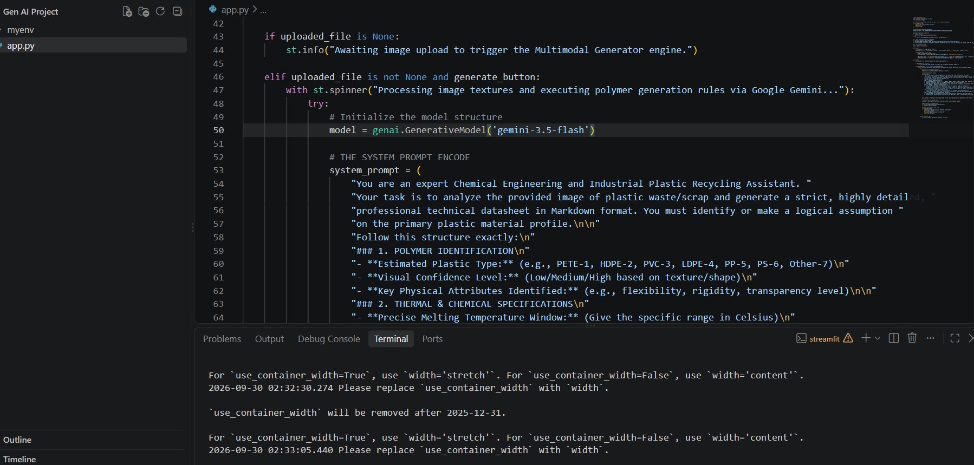
Result

Slide 8
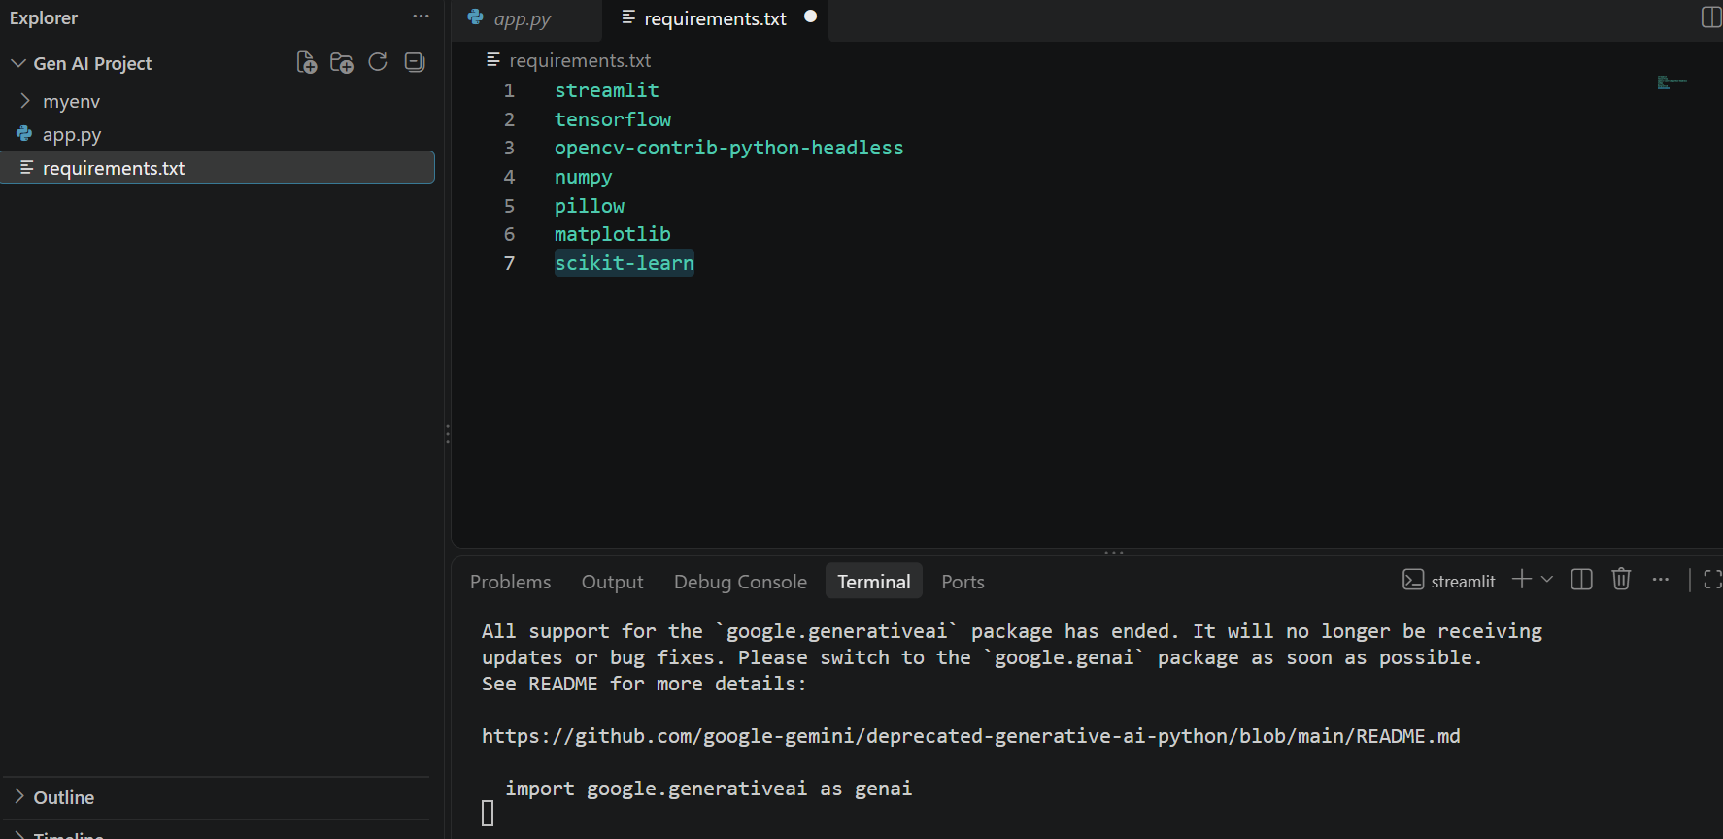
Result

Slide 9
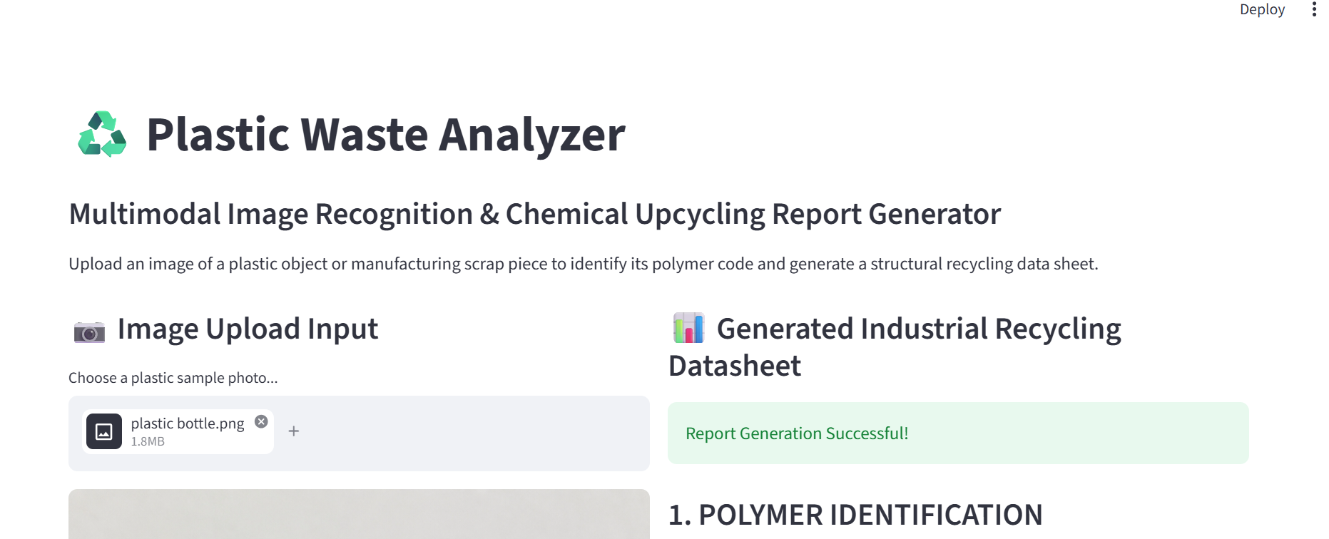
Result

Slide 10
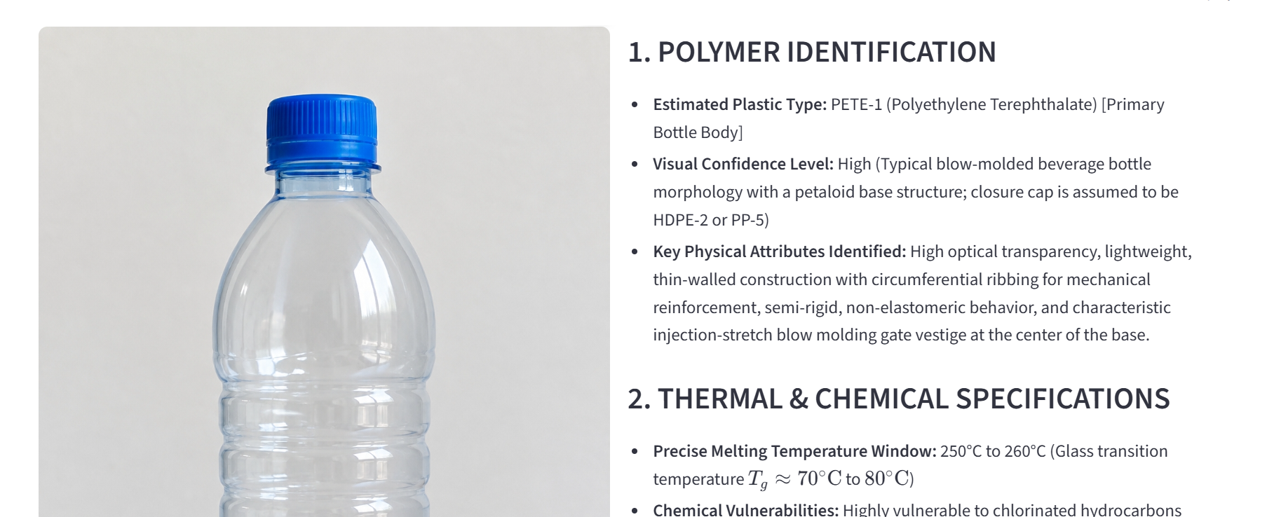
Result

Slide 11
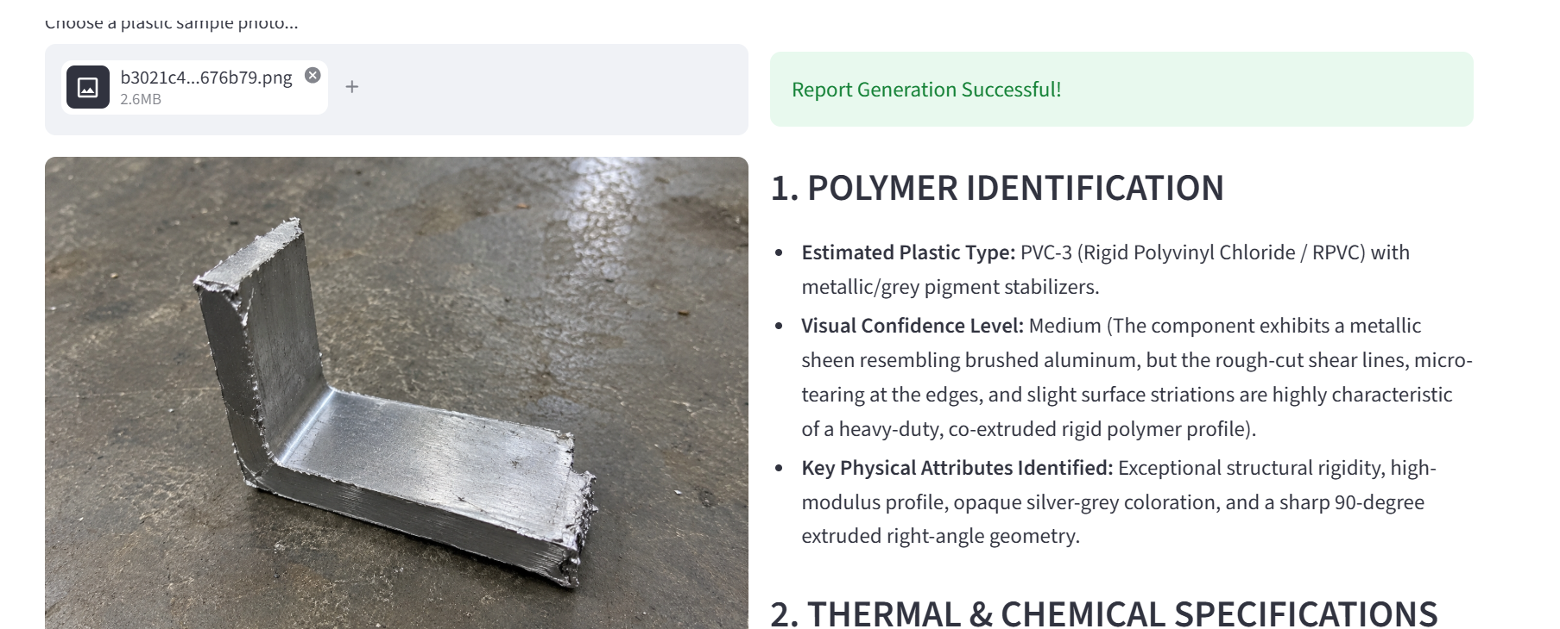
Result

Slide 12
Conclusion
The project demonstrates how generative artificial intelligence and computer vision can support waste management by predicting a waste item's material category and proper disposal path.
Real-time waste classification: Delivers instant predictions on uploaded image files.
Interactive visual input: Allows users to easily drop and test various material images.
Probability-based results: Displays direct confidence scores alongside classification targets.
High overall classification accuracy: Minimizes sorting errors via a pre-trained multimodal model.
Easy-to-use Streamlit interface: Provides a clean, accessible layout designed for public users.
Practical application of Generative AI: Deploys a zero-shot visual prompting strategy for ecological sustainability

Slide 13
Future scope
Improve prediction performance with advanced ML algorithms and prompt tuning frameworks.
Add resin identification capabilities for automatic plastic sorting refinement.
Introduce explainable AI framework models to detail pixel-level classification insights.
Add real-time classification metrics tracking based on historical recycling user patterns.
Develop an automated sorting router application for smart physical recycling infrastructure.
Integrate the application with real-time video streaming and continuous webcam image feeds.
Deploy the system as a scalable production application integrated directly into public cloud environments..

Slide 14
References
IBM SkillsBuild Learning Platform: Foundational coursework in applied Artificial Intelligence, Machine Learning pipelines, and sustainable technology.
Google Gemini API Technical Documentation: Reference manuals for visual analysis models using the google-generativeai developer SDK.
Streamlit Core Framework Documentation: UI components layout guidelines and production application cloud deployment strategies.
Edunet Foundation Internship Program: Project guidelines, capstone requirements, and mentor evaluation criteria.

Slide 15
Deployment link / github link
Github Link: https://github.com/ayushisharmaglobal-sketch/Plastic-Waste-Analyzer.git
Live Plastic Waste Analyzer app

Slide 16
THANK YOU

